Slide 1
LECTURE 07: STORYTELLING
November 1, 2016
SDS136:
Communicating with Data

Slide 2
Announcements
T-minus 7 weeks until the end of the semester (officially halfway done)!
Coming up: Final Projects

Slide 3
Final project
Goal: apply the visualization techniques we’ve learned to a real-world dataset you care about
May work in groups (recommended) or on your own
Deliverable: an interactive visualization that will be demonstrated during our end-of-semester reception and a 2-page write up of the methods you used
Example problems

Slide 4

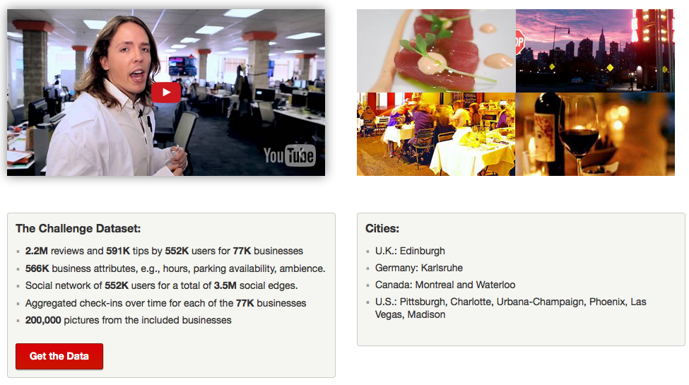
dataset challenge
www.yelp.com/dataset_challenge

Slide 5
dataset challenge: example ?s
Cultural Trends: What makes a particular city different? For example, in which countries are Yelpers sticklers for service?
Location Mining: How much of a business' success is really just location, location, location? Do reviewers' behaviors change when they travel?
Seasonal Trends: What about seasonal effects: are there more reviews for sports bars on major game days?
Infer Categories: Do you see any non-intuitive correlations between business categories e.g., how many karaoke bars also offer Korean food, and vice versa?
Social Graph Mining: Can you figure out who the trend-setters are? For example, who found the best waffle joint before waffles were cool?

Slide 6
FP1: Topic Post
Due tonight at 11:59pm: a quick Piazza post about a potential final project topic
Please include:
A description of the domain
The problem(s) you're trying to solve / question(s) you're trying to answer
The audience
The data you’ll be using (if you know)
Not 100% sure? Try a couple and get some feedback (you’re free to change your mind later)
See a topic you like? Reply to the post and form a team!

Slide 7
FP2: Preliminary Sketches
Due next week: rough sketches of some ideas for your visualization (more on this Thursday)

Slide 8

Storytelling with visualization

Slide 9

Discussion
What makes a good story?
storyteller
audience

Slide 10

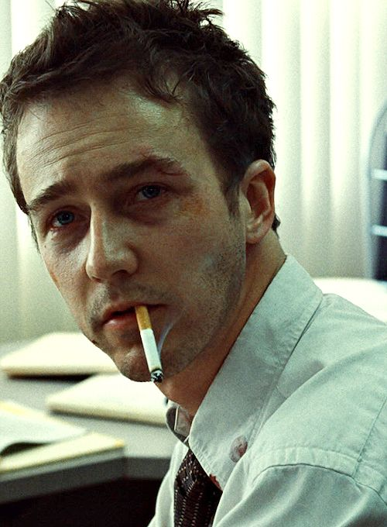

Slide 11
Discussion
What makes a good story?
storyteller
point
audience

Slide 12
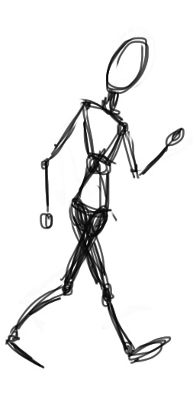


Slide 13
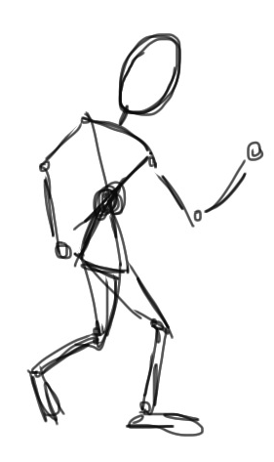

Slide 14
What is that
story about?

Slide 15

What is that
story about?
point

Slide 16
What is that
story about?
point

Slide 17
Ways to get to the point
Climax
of Act 2
Midpoint
(plot twist!)
Crisis
Disaster
Climax
of Act 3
Obstacle
Climax
of Act 1
Obstacle
Obstacle
DESCENDING ACTION
Second
Thoughts
ASCENDING ACTION
Inciting
Incident
Wrap-up
Beginning
End
Act 1
(set up)
Act 2
(confrontation)
Act 3
(resolution)
Three Act Structure

Slide 18
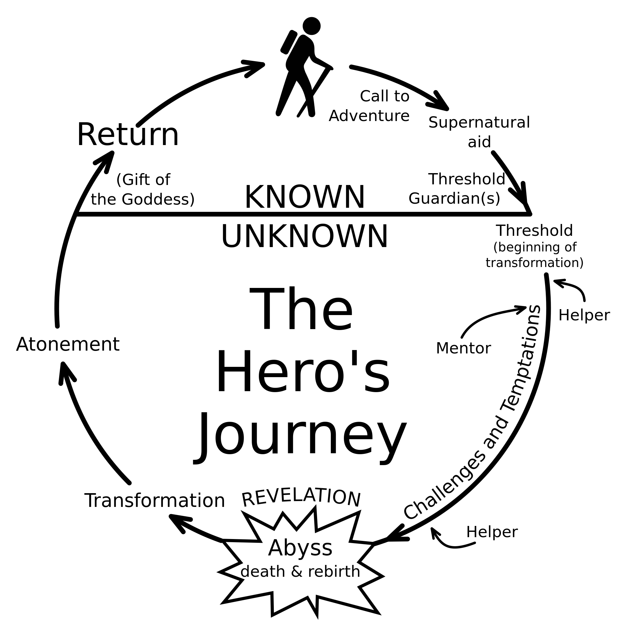
Ways to get to the point

Slide 19
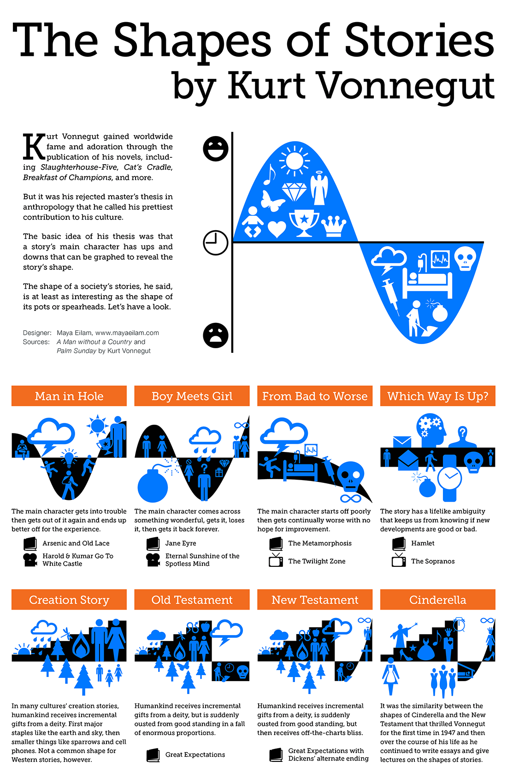
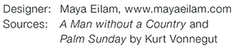
Ways to get to the point according to Vonnegut

Slide 20

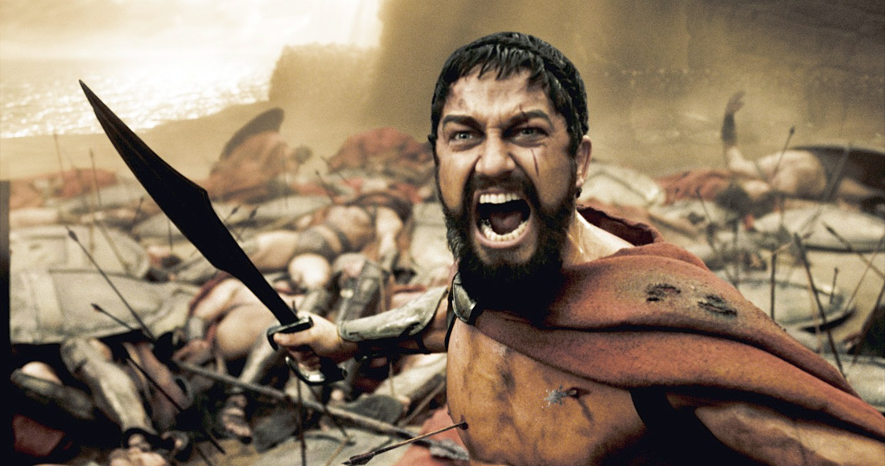
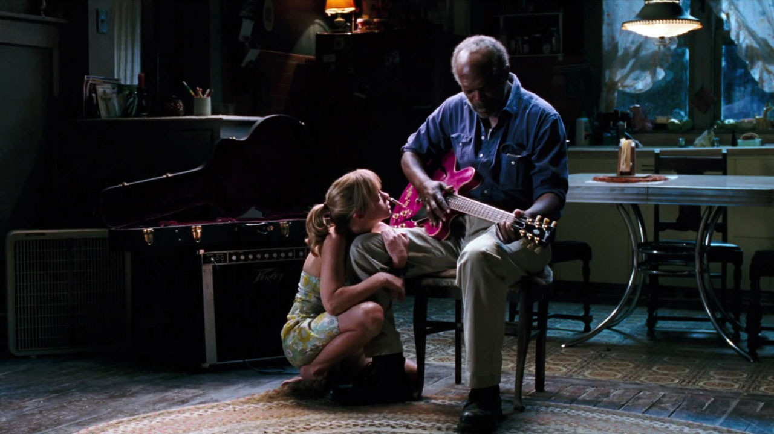


Slide 21





Slide 22
And a bunch of other stuff, too…
Touches people
Characters change through experience
What makes a good story?
storyteller
Has substance
Makes people laugh
Has good characters
Representative of the human condition
Embraces idiosyncrasies
Relatable
Have something non-trivial at stake
point
audience
Honest
Must arrive somewhere
Outer struggle
Makes people cry
Imaginable setting
Creates vivid images
Plot structure
Inner struggle
Goes beyond the five senses
Doesn’t default to an easy solution

Slide 23
Storytelling with visualization

Slide 24
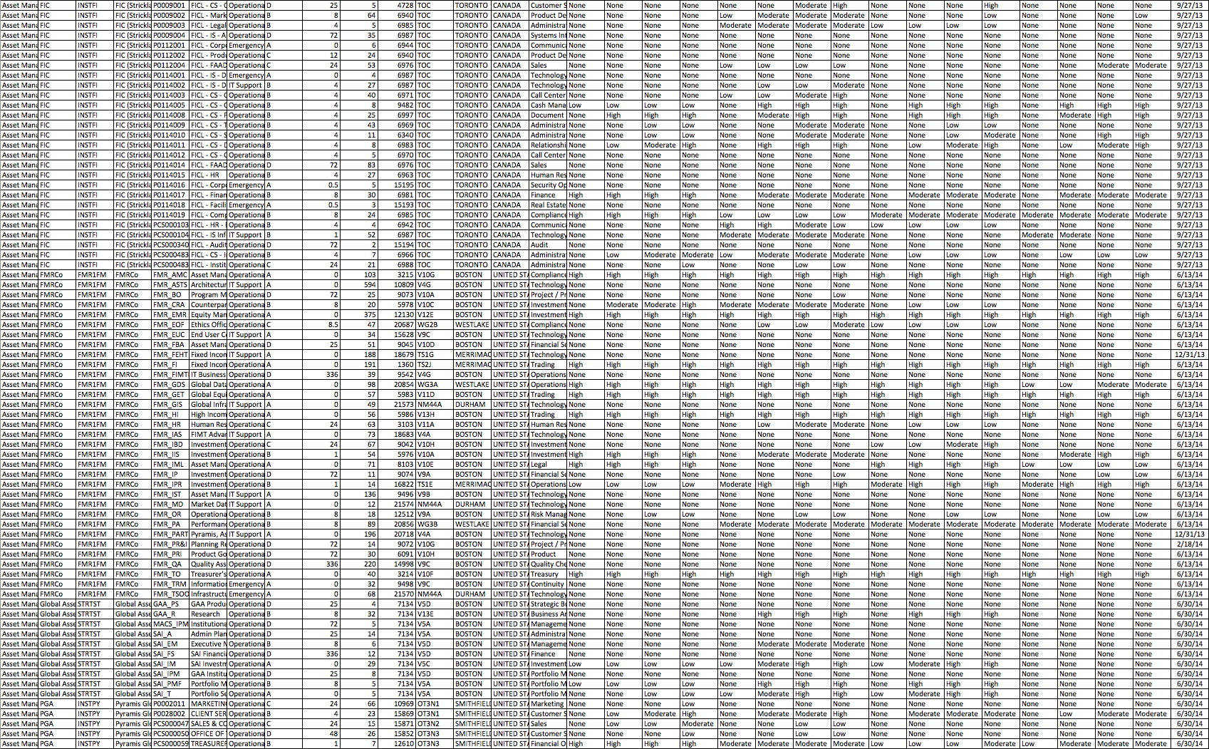
Discussion
What makes a good data story?

Slide 25

Napoleon’s March
“Figurative Map of the successive losses in men of the French Army in the Russian campaign 1812-1813.”
Drawn by Mr. Charles Minard, Inspector General of Bridges and Roads in retirement. Paris, 20 November 1869.

Slide 26
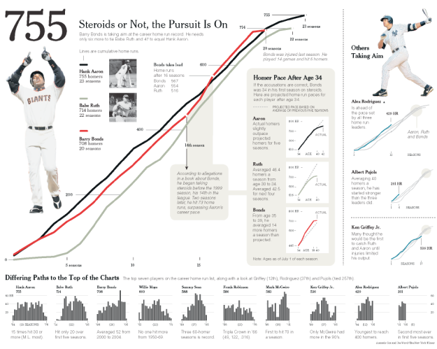
Baseball

Slide 27

Wealth inequality in the US (animated)

Slide 28

Wealth inequality in the US (interactive)

Slide 29
Lab 6: telling stories in Tableau
Instructions for today’s lab are available at:
http://www.science.smith.edu/~jcrouser/SDS136/labs/lab7
We’ll again be working with the Tuberculosis dataset; I’ve given you a few visualizations to start with, or you can use your own from last week
To get credit for this lab, follow the Piazza prompt at the end of the page

Slide 30
For next class
Remember to post to Piazza re: project topics
We’ll have a workshop on Wednesday to kick off your projects, give me a heads up if you’re going to miss class
If you’re stuck on picking a topic, or if you need help finding someone to work with, let me know!

